Slide 1
Transformer Model and GPT

Slide 2
Introduction

Slide 3
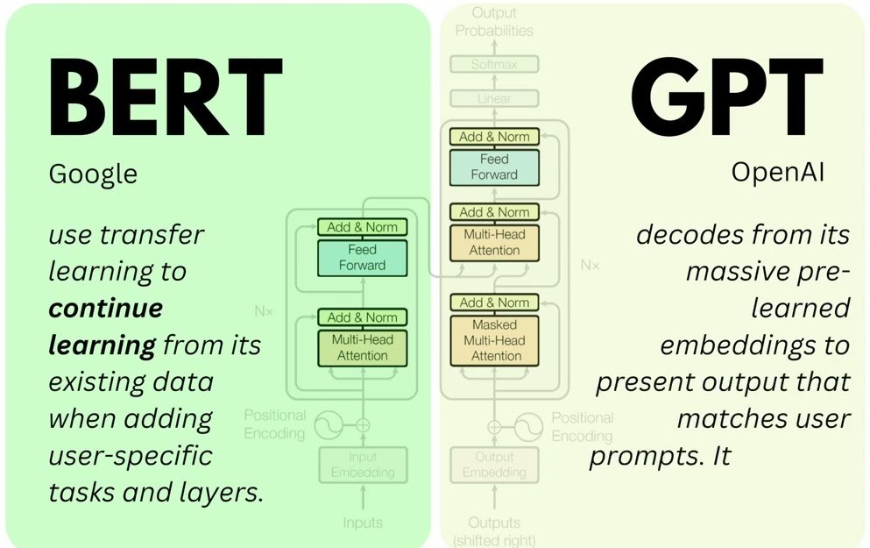

encoder only transformer
decoder
https://sushant-kumar.com/blog/bert
Notes:
https://jalammar.github.io/illustrated-bert/

Slide 4

Translator using Transformer (1)

Slide 5

Translator using Transformer – Encoders/Decoders (2)

Slide 6

Translator using Transformer: layered Encoder/decoder (3)

Slide 7
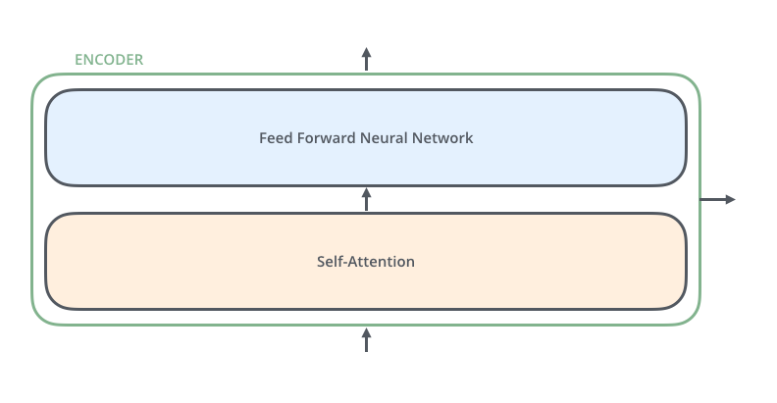
Encoder (4)

Slide 8

Encoder and Decoder (5)

Slide 9


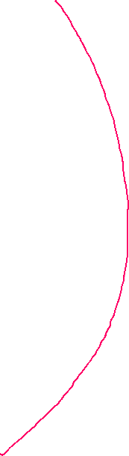

Slide 10
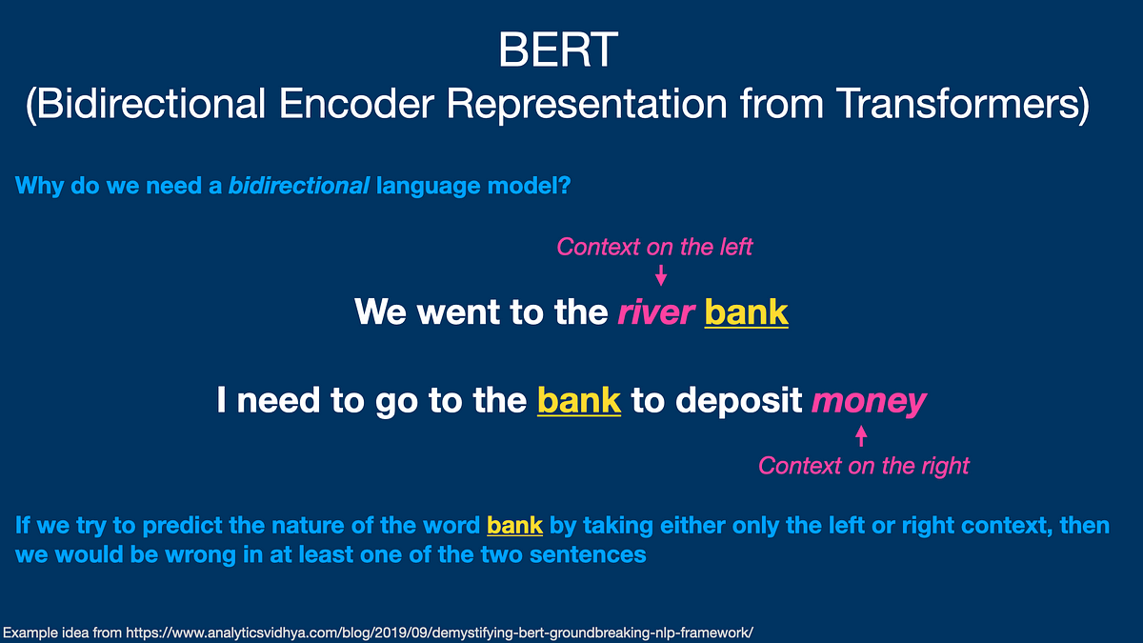
The Core Idea: Self-Attention
BERT attends to all other words in the sequence in both directions (left and right context) to understand the relationships between them

Slide 11
Video tutorial

Slide 12
Key concepts
Attention mechanisms in Large Language Models
BERT internal work
Attention mechanisms (with math)
Transformer models

Slide 13
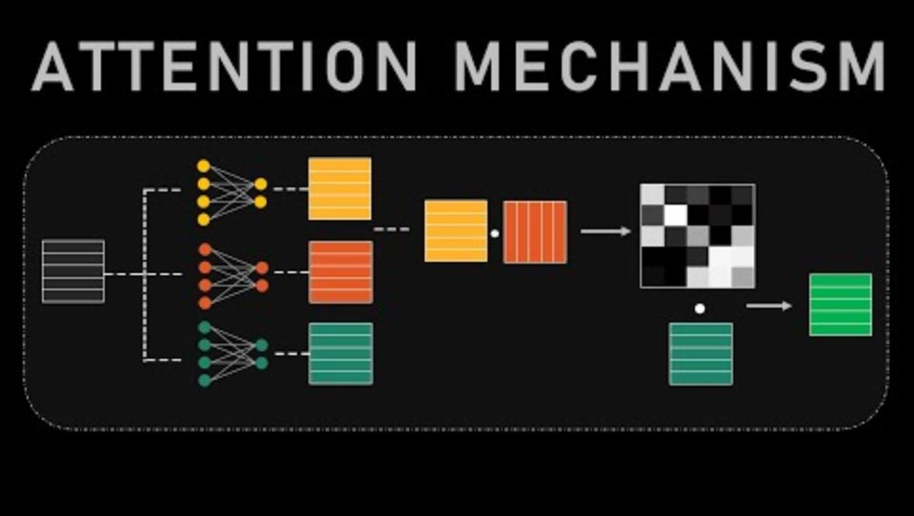

Slide 14
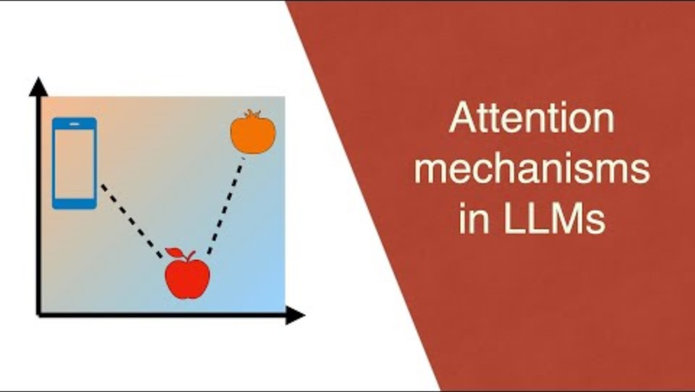

Slide 15
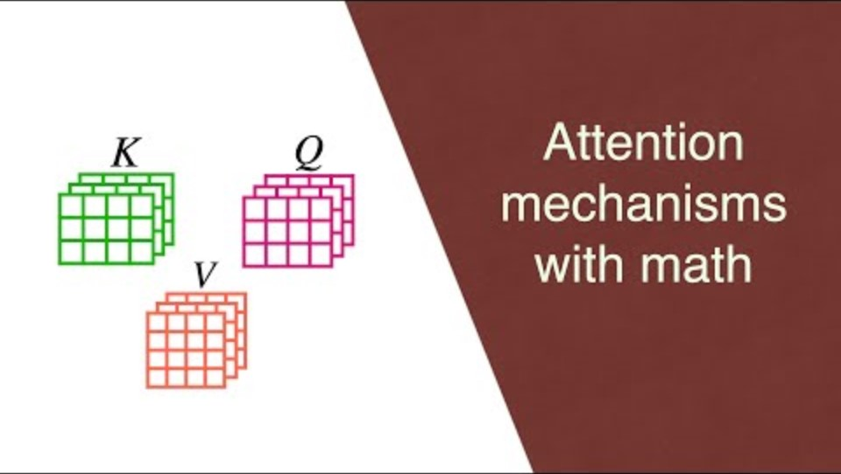

Slide 16
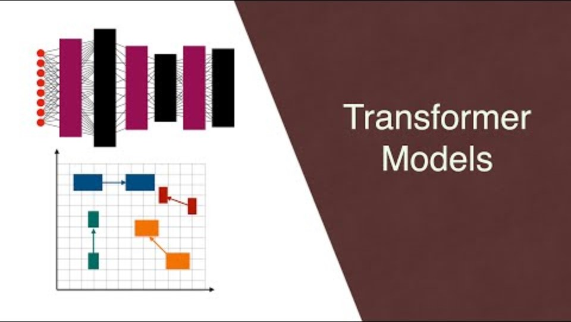

Slide 17
Implement an English-to-Chinese Translator

Slide 18
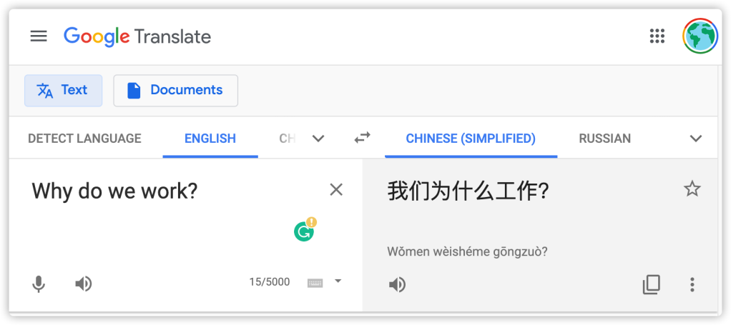

Slide 19
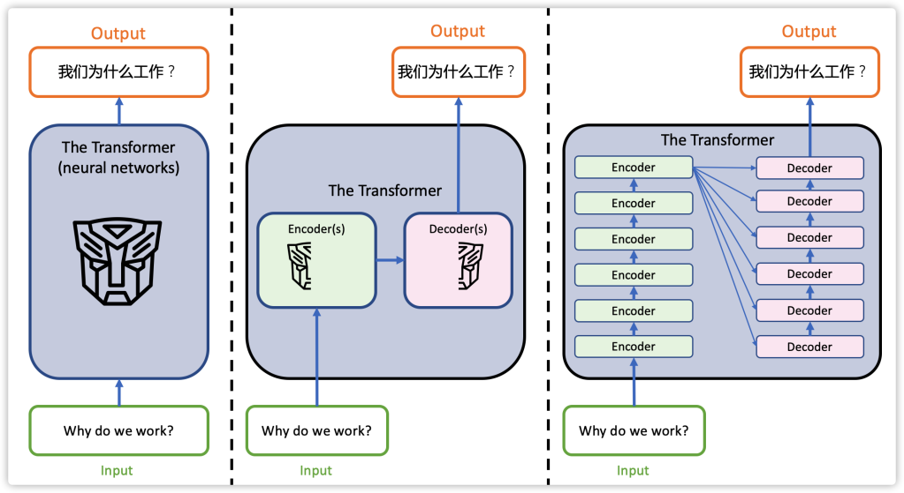

Slide 20
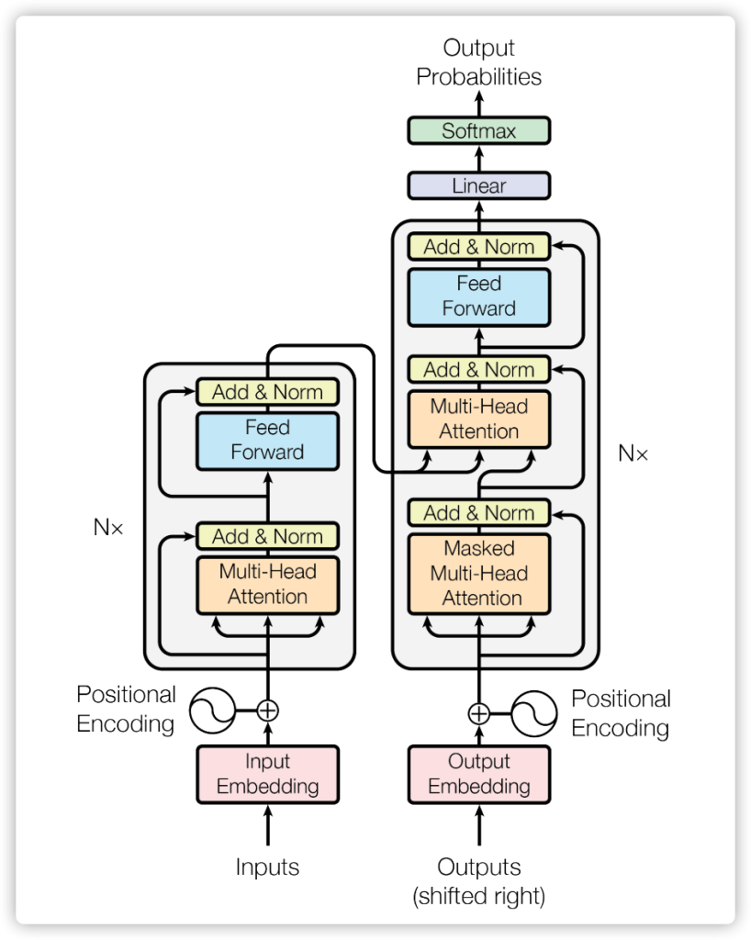

Slide 21
Use a trained model vs. Train from scratch
Use a trained model (code provided)
Helsinki-NLP/opus-mt-en-zh (https://huggingface.co/Helsinki-NLP/opus-mt-zh-en)
Developed by: Language Technology Research Group at the University of Helsinki
Quick demo
Train from scratch (not covered in the class)
https://cuicaihao.com/the-annotated-transformer-english-to-chinese-translator/
Help you understand every detail

Slide 22
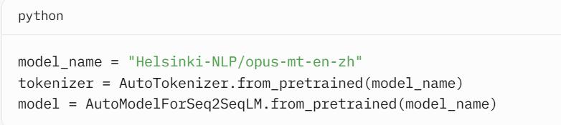

Loads the transformer model with:
Encoder to process English input.
Decoder to generate Chinese output.
Pre-trained weights optimized for translation

Slide 23
Reference
https://medium.com/@govindarajpriyanthan/self-attention-mechanism-in-transformers-1e46af9e1afb
https://jalammar.github.io/illustrated-transformer/
https://www.jeremyjordan.me/transformer-architecture/
https://poloclub.github.io/transformer-explainer/
https://www.comet.com/site/blog/explainable-ai-for-transformers/
https://cuicaihao.com/the-annotated-transformer-english-to-chinese-translator/
https://cuicaihao.com/the-annotated-transformer-english-to-chinese-translator/
https://www.youtube.com/watch?v=kCc8FmEb1nY

Slide 24
Homework
Watch video https://www.youtube.com/watch?v=wjZofJX0v4M
List three questions and provide answers with a visualized explanation

Slide 25
